Slide 1




Lipizzaner: Gradient-based Coevolution GAN Training
JAMAL TOUTOUH jamal@lcc.uma.es
jamal.es
@jamtou
14-Nov-21
Jamal Toutouh
Notes:
Introducing myself, Una-May (ALFA), and Enrique (NEO)

Slide 2
Generative
Models

Slide 3
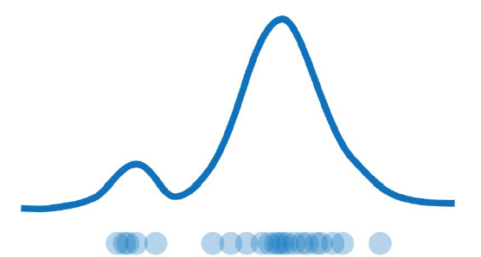
Generative Modeling
Goal: Given a distribution of data, take input training samples from it and learn a model that represents that distribution
Density estimation
Understand better the data distribution
Compress the data representation
Generate samples

Slide 4
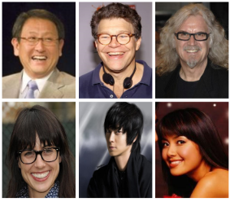
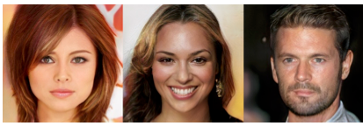
Generative Modeling
Goal: Given a distribution of data, take input training samples from it and learn a model that represents that distribution
Density estimation
Synthetic samples generation
Training samples
Synthetic samples

Slide 5
Models
Autoencoders and Variational Autoencoders (VAEs)
Generative Adversarial Networks (GANs)
x
x
E
z
D
x'
D
y
z
G
x'

Slide 6
Generative Adversarial
Networks

Slide 7
Generating synthetic samples
y
y
y
x
x
x

Slide 8
Generating synthetic samples
Global idea: Generating new synthetic samples without modeling the density estimation (for “complex” distributions)
Solution: Sampling from something simple (noise) and learning a transformation to the real (training) distribution
Main components of the Generative Model:
Generator Neural Network → G
Noise (latent space) → Z
Fake sample from the training distribution → X’
Z
G
X'

Slide 9
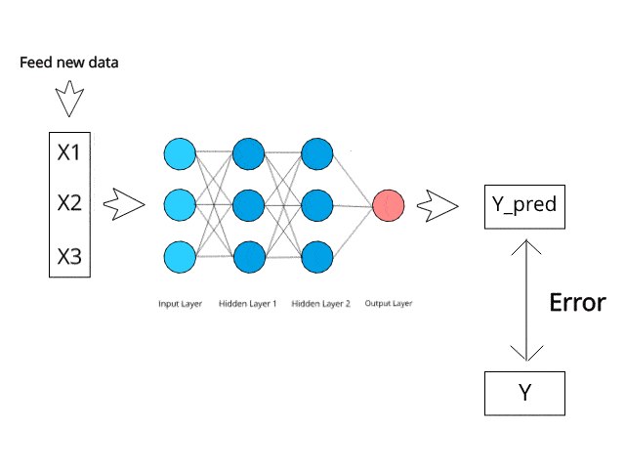
How Generator Learn?
Z
G
X'
Using another model that gives information about how close/far are the samples from real data → Discriminator

Slide 10
Generative Adversarial Networks
Generative Adversarial Networks: Construct a generative model by raising an arms race between two neural networks, a generator and a discriminator
Discriminator (D) tries to distinguish between real data (X) from the real data distribution and fake data (X’) from the generator (G)
Generator (G) learns how to create synthetic/fake data samples (X') by sampling random noise (Z) to fool the discriminator (D)
x
D
y
z
G
x'

Slide 11
GAN Training. Mathematical Model
Discriminator is trained to correctly classify the input data as either real or fake
maximize the probability that any real data input x is classified as real → maximize D(x)
minimize the probability that any fake sample x’ is classified as real → minimize D(G(z))
Generator is trained to fool the Discriminator by generating realistic data
maximize the probability that any fake sample is classified as real
→ maximize D(G(z))
x
In practice, the logarithm of the probability (e.g. log D(…)) is used in the loss functions
GAN training as a minmax optimization problem
D
y
z
G
x'

Slide 12
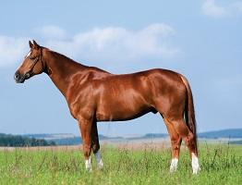
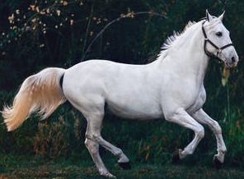
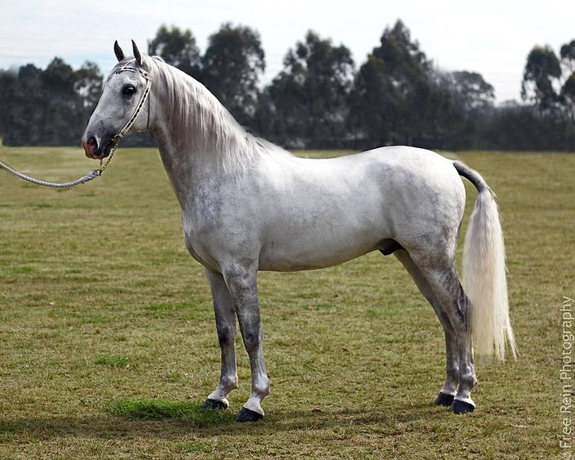
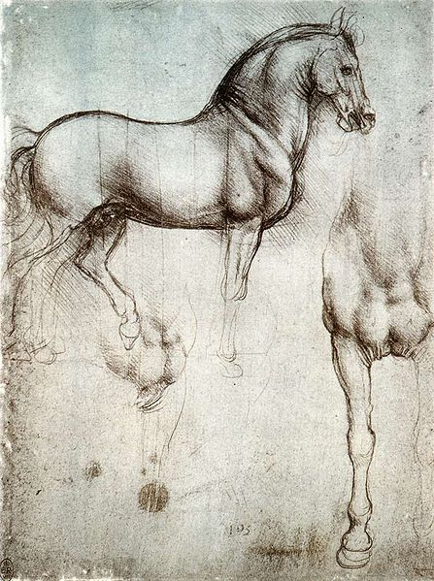
Generative Adversarial Networks
Generative Adversarial Networks: Construct a generative model by raising an arms race between two neural networks, a generator and a discriminator
real data
Goodfellow et al. 2014. Generative Adversarial Nets
D
y
fake sample
this is real or this is fake
z
G
noise

Slide 13
GAN Training. General Algorithm
Steps of the main training loop:
1. Train discriminator
1.1. Train discriminator on real data
1.1.1 Sample a batch of data from real dataset (x)
1.1.2 Get loss from the discriminator output with input x
1.2 Train the discriminator on data produced by the generator
1.2.1 Sample a batch of data from random latent space (z)
1.2.2 Get samples (x’) from the generator with input z
1.2.3 Get loss from the discriminator output with input x’
1.3 Update discriminator weights according to the losses
2. Train the generator
2.1 Sample a batch of data from random latent space (z)
2.2 Get samples (x’) from the generator with input z
2.3 Get loss from the discriminator output with input x’
2.4 Update generator weights according to the losses
x
D
y
z
G
x'

Slide 14
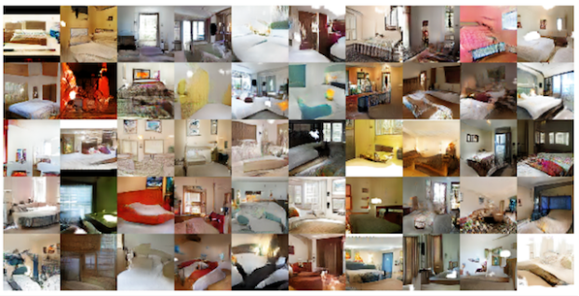
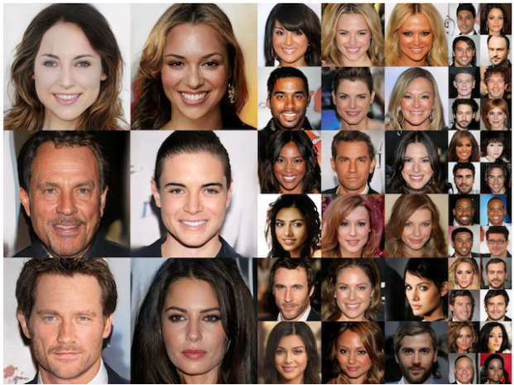
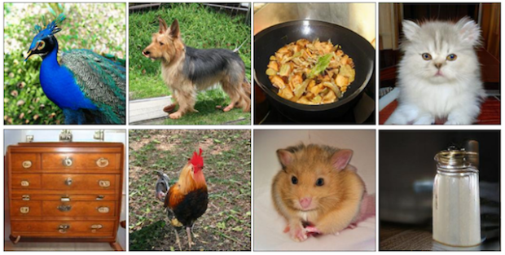
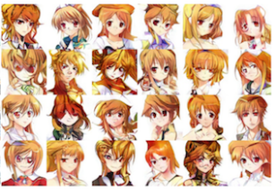
Applications: Generate New Samples of Image Datasets

Slide 15
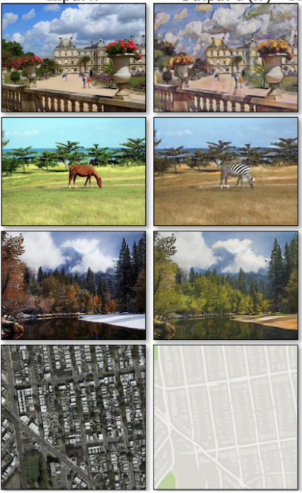
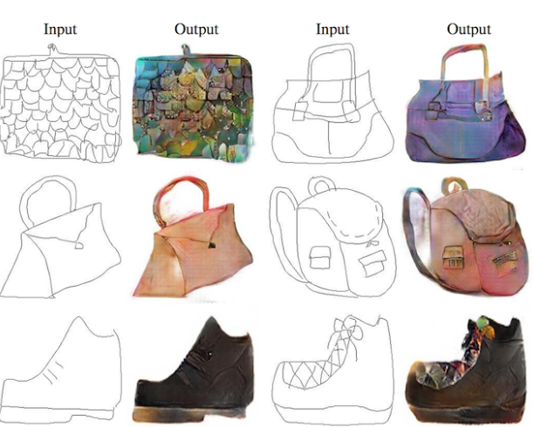
Applications: Image-to-Image Translation

Slide 16
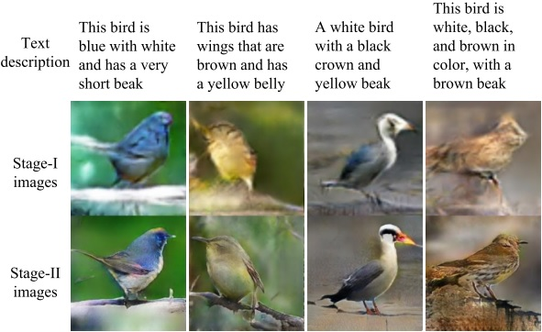
Applications: Text-to-Image Translation

Slide 17
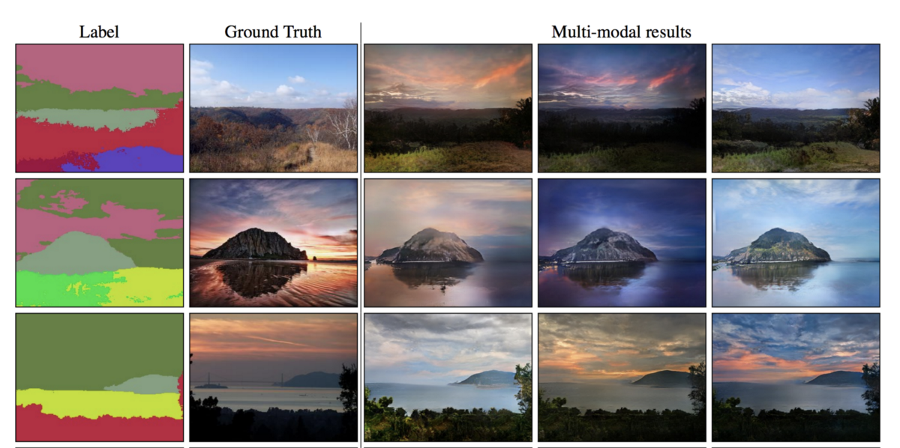
Applications: Semantic-Image-to-Photo Translation
http://nvidia-research-mingyuliu.com/gaugan

Slide 18
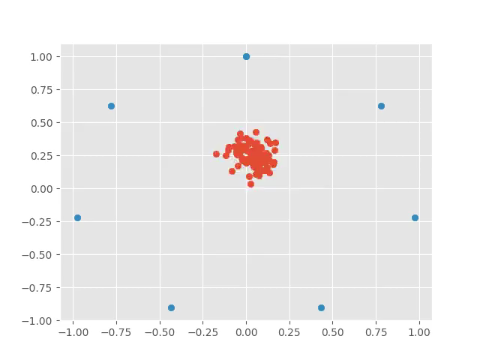
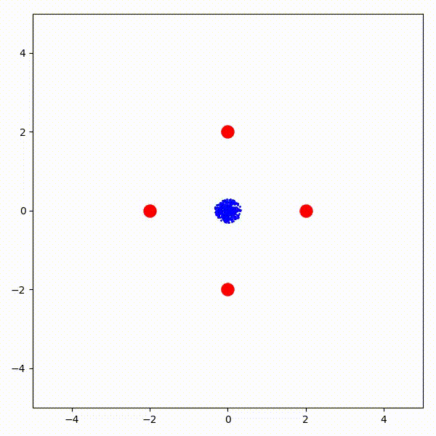
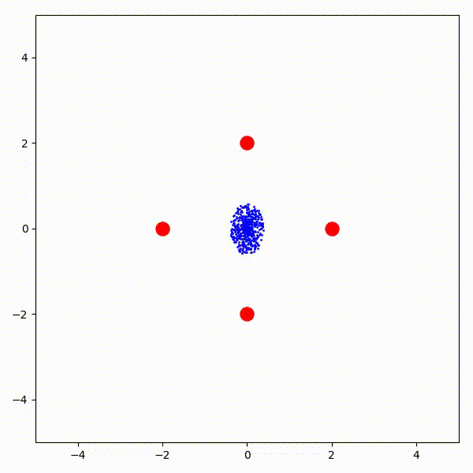
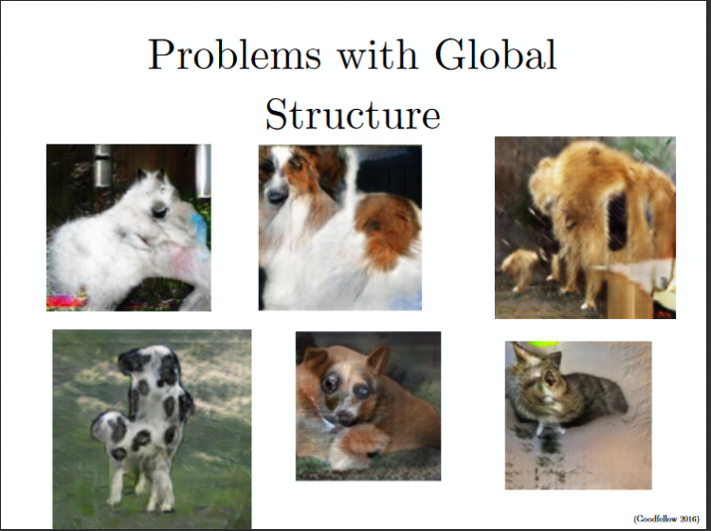
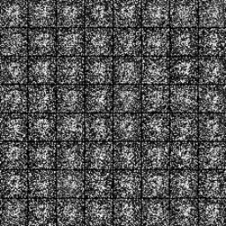
Not all is good news
Non-convergence: the model parameters oscillate, destabilize and never converge
Mode collapse: the generator collapses which produces limited varieties of samples
Diminished gradient: the discriminator gets too successful that the generator gradient vanishes and learns nothing

Slide 19
Lipizzaner

Slide 20
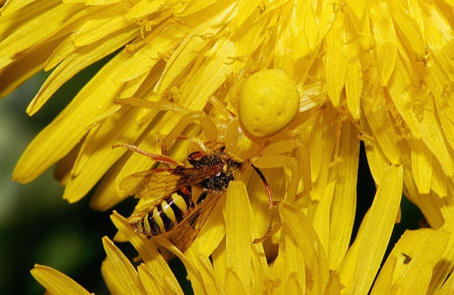
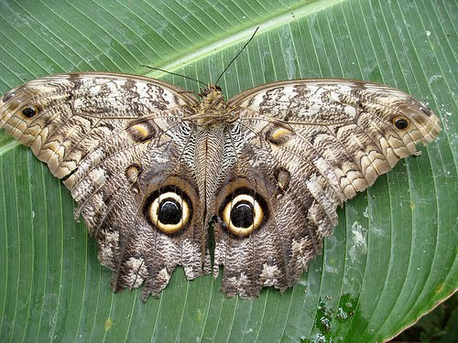
From GANs to Deep Neuroevolution
GAN training can be seen as a two-player minmax game (generators 𝐺(𝑧) vs discriminators 𝐷(𝑥))
Evolutionary computing community has already addressed similar issues in two-player minmax optimization
Focusing, relativism or loss of gradient
Competitive Coevolution, two different populations
(adds diversity → robustness)

Slide 21
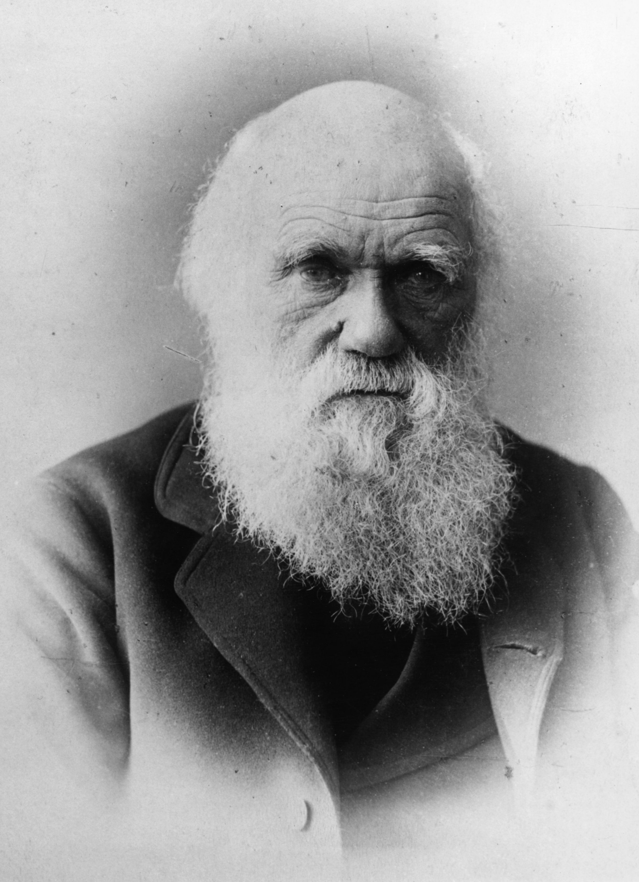
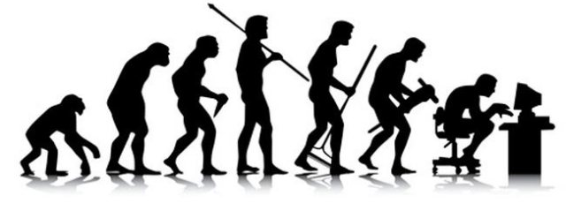
Introduction to Evolutionary Computing
Darwinism:
"I have called this principle, by which, each slight variation, if useful, is preserved, by the term of Natural Selection. … The expression often used by Mr. Herbert Spencer of the Survival of the Fittest is more accurate, and is sometimes equally convenient.“
Charles Darwin
On the Origin of Species by means of Natural Selection, 1859
Evolution of species through a gradual process of natural selection

Slide 22
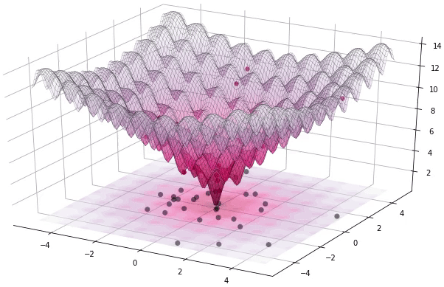
Introduction to Evolutionary Computing
Evolutionary Computing comprises a set of computational methods (metaheuristics) that mimics biological evolution
They apply a mechanism analogous to natural evolutionary processes, to solve search and optimization problems
They work with a population (of representations) of solutions
Principles: natural selection (fitness), reproduction (recombination and mutation) and genetic diversity
They follow the idea of survival of the fittest individuals, evaluating the fitness according to the problem to be solved, through a fitness function

Slide 23
Introduction to Evolutionary Computing
Evolutionary Algorithm
generation = 0
population(0) = Create initial population
while not stop criteria do
evaluate(population(generation))
parents = selection(population(generation))
offspring = recombine(parents, recombination_probability)
offspring = mutate(parents, mutation_probability)
new_population = replace(offspring, population(generation))
generation++
population(generation) = new_population
Initialization
Mutation
Evaluation
Recombination
Selection
Termination

Slide 24
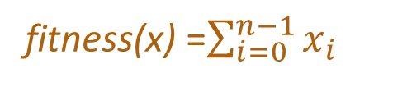
Introduction to Evolutionary Computing
Example: One-Max problem
Maximizing the number of 1s of a bitstring of length n (i.e., composed by 1s and 0s)
Optimum
1 | 1 | 1 | 1 | 1 | 1
They work with a population (of representations) of solutions
Fitness
gene
1 | 0 | 1 | 1 | 0 | 0
1 | 1 | 1 | 1 | 0 | 0
population
chromosome
0 | 0 | 1 | 0 | 1 | 0
0 | 0 | 0 | 1 | 0 | 0
fitness(x) =$\sum_{i=0}^{n−1}{x_{i}}$

Slide 25
Introduction to Evolutionary Computing
Example: One-Max problem
Maximizing the number of 1s of a bitstring of length n (i.e., composed by 1s and 0s)
They work with a population (of representations) of solutions
Recombination
Mutation
1 | 0 | 1 | 1 | 0 | 0
0 | 0 | 1 | 0 | 1 | 0
1 | 1 | 1 | 1 | 0 | 0
0 | 0 | 0 | 1 | 0 | 0
p1 =
o1 =
1 | 0 | 1 | 0 | 1 | 0
p1 =
1 | 0 | 1 | 1 | 0 | 0
o1 =
1 | 0 | 1 | 0 | 0 | 0
1 | 0 | 1 | 1 | 0 | 0
p2 =
o2 =
0 | 0 | 1 | 1 | 0 | 0
p2 =
0 | 0 | 1 | 0 | 1 | 0
o2 =
0 | 0 | 1 | 1 | 1 | 0
0 | 0 | 1 | 0 | 1 | 0
One-point crossover
Two-point crossover
o1 =
0 | 0 | 1 | 0 | 1 | 0
o2 =
0 | 0 | 0 | 0 | 1 | 0
o1 =
0 | 0 | 1 | 0 | 1 | 0
o2 =
0 | 0 | 0 | 0 | 1 | 1
Bit flip mutation
Swap mutation

Slide 26
Introduction to Evolutionary Computing
1. Initialization
2. Evaluation
Population
Initialization
fit (s₀)=3
1 | 0 | 1 | 1 | 0 | 0
0 | 0 | 0 | 1 | 0 | 0
fit (s₃)=1
fit (s₁)=1
0 | 0 | 1 | 0 | 0 | 0
Mutation
0 | 0 | 1 | 0 | 1 | 0
fit (s₄)=2
fit (s₂)=4
1 | 1 | 1 | 1 | 0 | 0
Evaluation
Recombination
average fitness=2.2
Selection
3. Selection (tournament selection)
Parents
1 | 0 | 1 | 1 | 0 | 0
vs
0 | 0 | 0 | 1 | 0 | 0
p1 =
1 | 0 | 1 | 1 | 0 | 0
Termination
0 | 0 | 1 | 0 | 0 | 0
vs
0 | 0 | 1 | 0 | 1 | 0
p2 =
0 | 0 | 1 | 0 | 1 | 0

Slide 27
Introduction to Evolutionary Computing
4. Recombination (two-point cx)
Parents
Initialization
p1 =
1 | 0 | 1 | 1 | 0 | 0
p1 =
1 | 0 | 1 | 1 | 0 | 0
o1 =
1 | 0 | 1 | 0 | 0 | 0
o2 =
Mutation
p2 =
0 | 0 | 1 | 0 | 1 | 0
p2 =
0 | 0 | 1 | 0 | 1 | 0
0 | 0 | 1 | 1 | 1 | 0
Evaluation
Recombination
5. Mutation (bit-flip)
Offspring
Selection
o1 =
1 | 0 | 1 | 0 | 0 | 0
o1 =
1 | 0 | 0 | 0 | 0 | 0
Termination
o2 =
0 | 0 | 1 | 1 | 1 | 0
o2 =
0 | 0 | 1 | 1 | 1 | 1

Slide 28
Introduction to Evolutionary Computing
6. Replacement (remove the less fit)
Population
Initialization
1 | 0 | 1 | 1 | 0 | 0
0 | 0 | 0 | 1 | 0 | 0
0 | 0 | 1 | 0 | 0 | 0
Mutation
0 | 0 | 1 | 0 | 1 | 0
1 | 1 | 1 | 1 | 0 | 0
Evaluation
Recombination
Offspring
Selection
o1 =
1 | 0 | 0 | 0 | 0 | 0
o2 =
0 | 0 | 1 | 1 | 1 | 1
Termination

Slide 29

Introduction to Evolutionary Computing
6. Replacement (remove the less fit)
Population
Initialization
fit (s₀)=3
1 | 0 | 1 | 1 | 0 | 0
fit (s₃)=1
fit (s₁)=1
0 | 0 | 0 | 1 | 0 | 0
0 | 0 | 1 | 0 | 0 | 0
Mutation
fit (s₄)=2
0 | 0 | 1 | 0 | 1 | 0
fit (s₂)=4
1 | 1 | 1 | 1 | 0 | 0
Evaluation
Recombination
1 | 0 | 0 | 0 | 0 | 0
fit (s₅)=1
Selection
0 | 0 | 1 | 1 | 1 | 1
fit (s₆)=4
average fitness=2.8
Termination

Slide 30
Introduction to Evolutionary Computing
2. Evaluation
Initialization
Population
fit (s₀)=3
1 | 0 | 1 | 1 | 0 | 0
Mutation
0 | 0 | 1 | 1 | 1 | 1
fit (s₃)=4
fit (s₁)=1
1 | 0 | 0 | 0 | 0 | 0
0 | 0 | 1 | 0 | 1 | 0
fit (s₄)=2
Evaluation
Recombination
fit (s₂)=4
1 | 1 | 1 | 1 | 0 | 0
average fitness=2.8
Selection
Termination

Slide 31
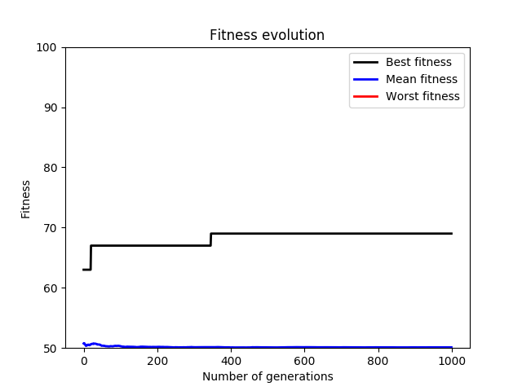
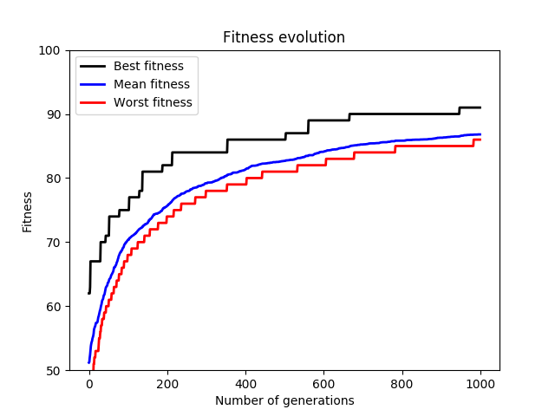
Introduction to Evolutionary Computing
Example: One-Max problem (n=100, 1000 generations, 10 offspring)
2¹⁰⁰ possible solutions = 1.23 x 10³⁰
Population size 100
1000 generations
Offspring size 10
Tournament selection
Two-point cx (0.5)
Bit-flip mutation (0.1)
Random search
Evolutionary Algorithm

Slide 32
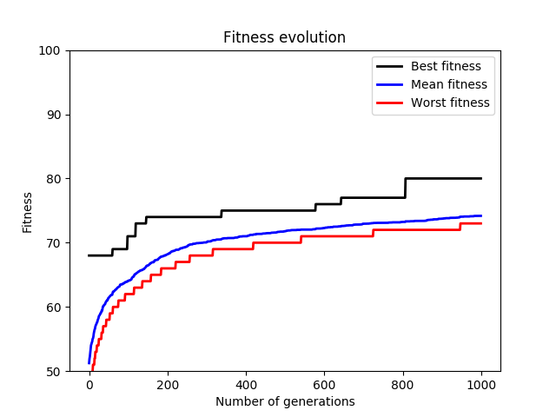
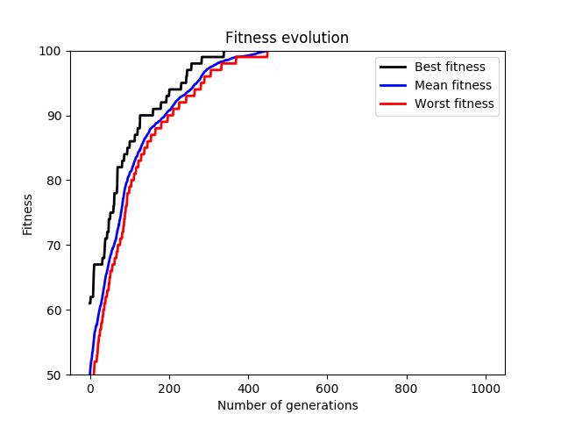
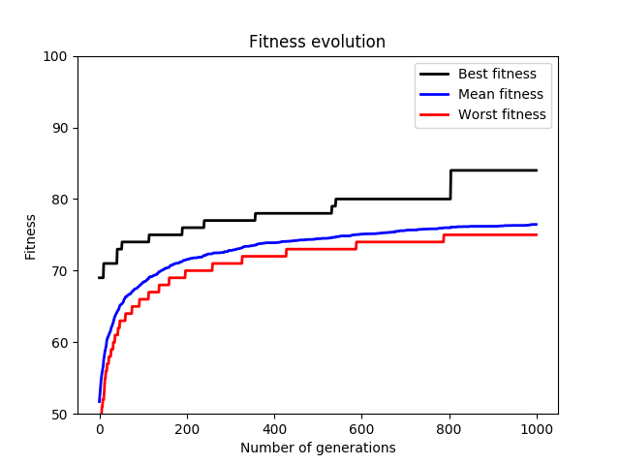
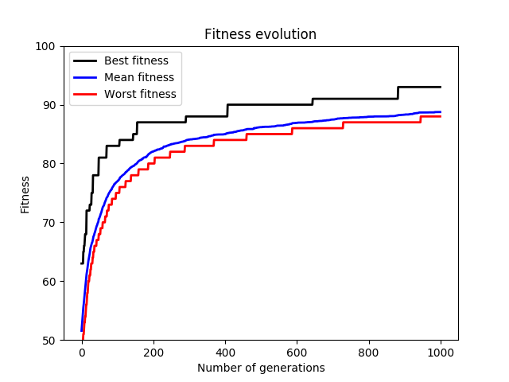
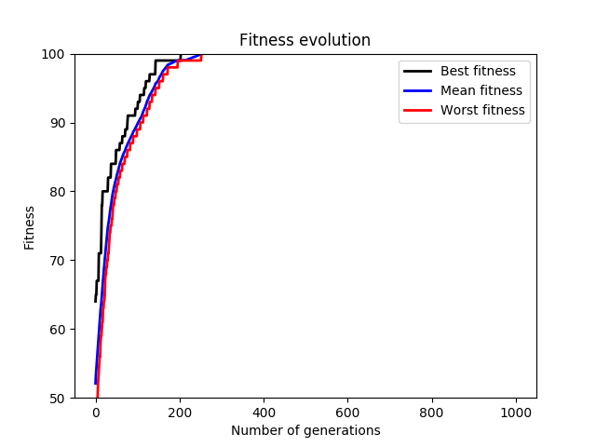
Introduction to Evolutionary Computing
Example: One-Max problem (n=100, 1000 generations, 10 offspring)
mut probability = 0.2
mut probability = 0.1
mut probability = 0.01
cx probability = 0.5
cx probability = 0.9

Slide 33
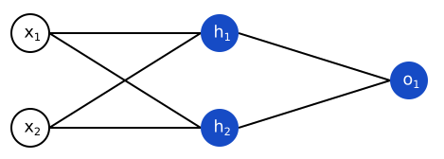
Introduction to Evolutionary Computing
Example: Neuroevolution → Train networks using EA
Compute the weights to minimize the error (loss) of the network
w₁₁
w₂₁
w₁₂
w₂₂
w₁₃
Representation:
Fitness: fitness(s) = loss(s, inputs, outputs)
w₁₄
w₁₁ | w₁₂ | w₁₃ | w₁₄ | w₂₁ | w₂₂
0.21 | 4.13 | -1.57 | 8.62 | -9.02 | 6.84
s_{i} Є [min_value, max_value]

Slide 34
Introduction to Evolutionary Computing
Example: Neuroevolution → Train networks using EA
Compute the weights to minimize the error (loss) of the network
They work with a population (of representations) of solutions
Recombination:
Mutation:
α is a constant between (0, 1), generally α=0.5
For two genes of two parents c_{p1} and c_{p2} (c_{p1} < c_{p2})
BLX-α selects a random value for chromosomes of offspring c_{o1} and c_{o2} in the range [c_{p1}- α(c_{p2}-c_{p1}), c_{p1}+ α(c_{p2}-c_{p1})]
p1 =
0.21 | 4.13 | -1.57 | 8.62 | -9.02 | 6.84
o1 =
0.21 | 4.13 | -1.57 | -0.98 | -4.12 | 8.75
c_{p1}
c_{p2}
p2 =
2.14 | -1.03 | 7.68 | -0.98 | -4.12 | 8.75
o2 =
2.14 | -1.03 | 7.68 | 8.62 | -9.02 | 6.84
1.13 | -2. 11 | 1.26 | 2.81 | -6.62 | 5.14
α(c_{p2}-c_{p1})
α(c_{p2}-c_{p1})
One-point crossover
BLX-α crossover
Swap mutation swaps to gens in the chromosome
Random mutation changes a chromosome by a random value between Є [min_value, max_value]
Gaussian mutation adds a value given by a gaussian distribution

Slide 35
Introduction to Evolutionary Computing
Example: Neuroevolution → Find the best network architecture
A. Camero, J. Toutouh, D.H. Stolfi, E. Alba Evolutionary Deep Learning for Car Park Occupancy Prediction in Smart Cities International Conference on Learning and Intelligent Optimization, LION 12, pp. 1-15, 2018.
A. Camero, J. Toutouh, J. Ferrer, E. Alba. Waste generation prediction under uncertainty in smart cities through deep neuroevolution. Revista de Ingeniería, Universidad de Antioquia, No.93, pp. 128-138, 2019.

Slide 36
Competitive Coevolution
In biology, coevolution occurs when two or more species reciprocally affect each other's evolution through the process of natural selection.
New Blue Generation
Blue Population
Candidate actions/strategies
Selection
High-performing
candidates retained
Variation
Crossover
Mutation
Evaluation
Candidates scored and ranked
according to fitness function
depending on the other population
Red Population
Candidate actions/strategies
Selection
High-performing
candidates retained
Variation
Crossover
Mutation
New Red Generation

Slide 37
Competitive Coevolution
In biology, coevolution occurs when two or more species reciprocally affect each other's evolution through the process of natural selection.
Video games AI
Cybersecurity
U. O’Reilly, J. Toutouh, M. Pertierra, D. Prado-Sanchez, D. Garcia, A. Erb-Luogo, J. Kelly, E Hemberg (2019). Adversarial Genetic Programming for Cyber Security: A Rising Application Domain Where GP Matters. Genetic Programming and Evolvable Machines (In Press).

Slide 38

Lipizzaner: Gradient-based Coevolution
Non-convergence
Mode collapse
Diminished gradient
Lipizzaner

Slide 39
Lipizzaner: Gradient-based Coevolution
A distributed, coevolutionary framework to train GANs with gradient-based optimizers
Generators_{i}
Discriminators_{i}
N
N
N
N
C
N
N
C
N
N
C
C
W
W
W
W
E
E
E
S
S
E
S
G_{i}
D_{i}
S
Evaluation: All-vs-all
W
W
C
C
Select the best pair (e.g., tournament)
W
W
C
E
E
C
E
E
w^{i}
G_{i}
D_{i}
Parents
S
S
Training: Update the weights
(mutation)
S
S
Mixture weight
Offspring
G_{i}
D_{i}
Neighborhood examples
1
2
3
1
2
3
4
5
6
4
5
6
N
N
W
C
C
W
7
8
9
7
8
9
G
D
S
E
E
S

Slide 40
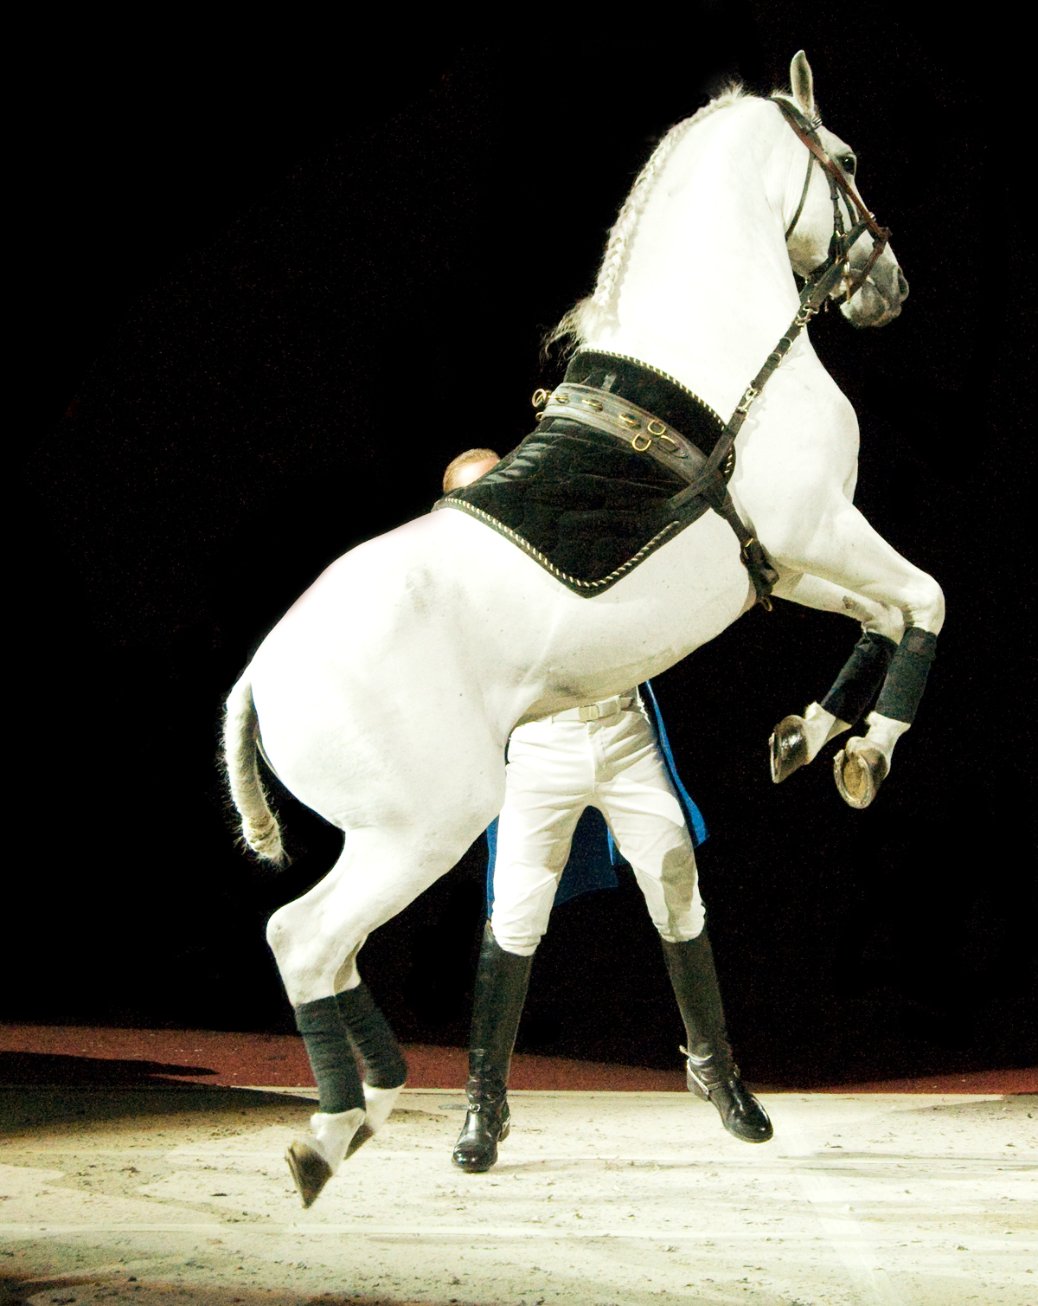
Lipizzaner: Gradient-based Coevolution
Lipizzaner is a distributed, coevolutionary framework to train GANs with gradient-based optimizers
Fast convergence due to gradient-based steps
Improved convergence due to hyperparameter evolution
Robustness and resilience due to coevolution
Diverse solutions due to mixture evolution
Scalability due to spatial distribution topology and asynchronous parallelism

Slide 41
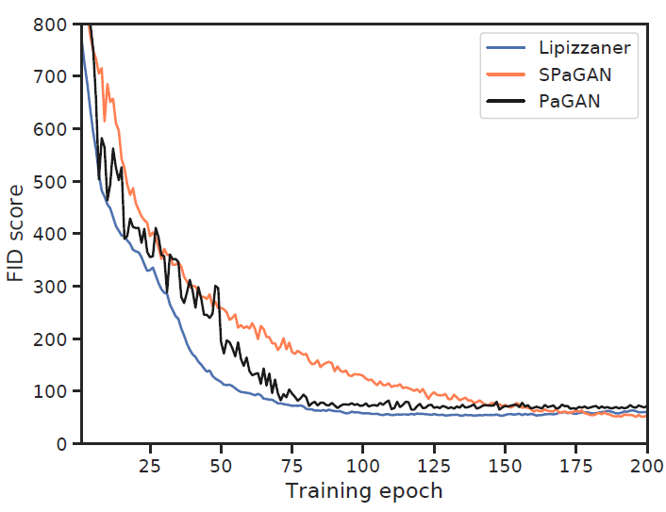
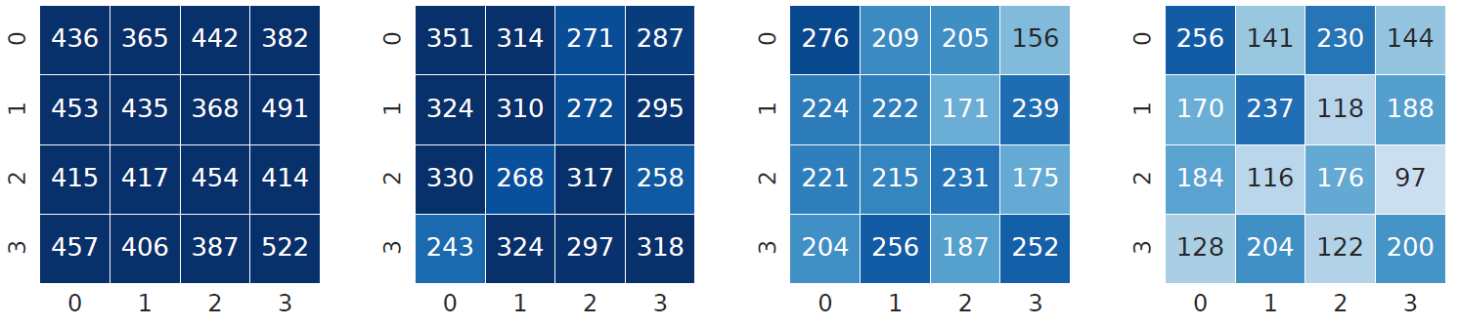
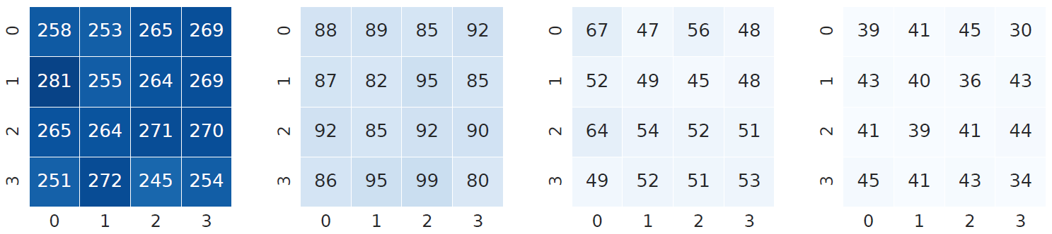
Fast and improved convergence
Lipizzaner → communication and performance-based selection pressure converge faster and avoids continuous fluctuations
SPaGAN – no selection/replacement
PaGAN – no communication
Epoch: 25
Epoch: 50
Epoch: 75
Epoch: 100
SPaGAN
FID→Accuracy
Lower is better
Lipizzaner

Slide 42
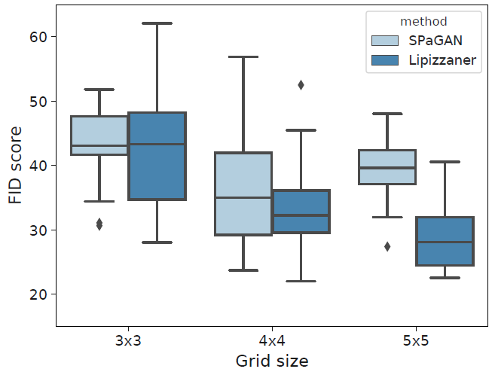
Fast and improved convergence
As the grid size increase (larger populations), the Lipizzaner converges to better generative models
Final results (FID)
FID→Accuracy
Lower is better

Slide 43
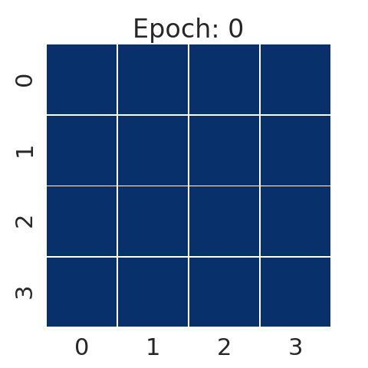
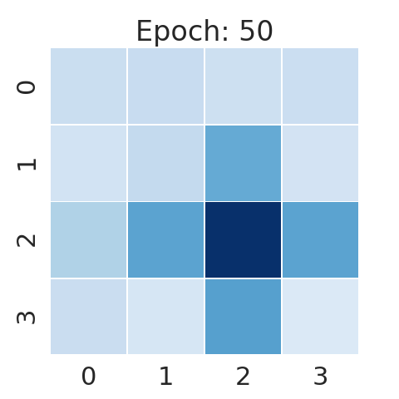
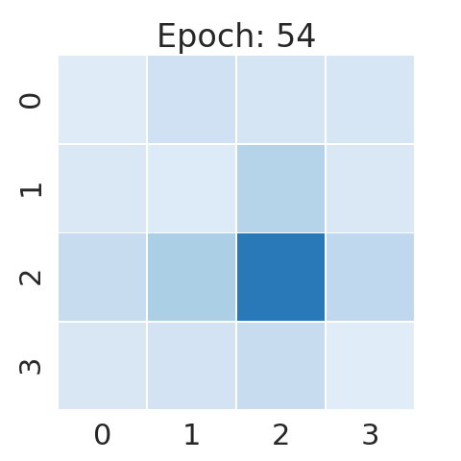
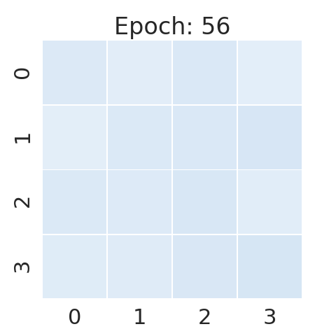
Robustness and resilience
Competitive coevolution allows the cells to escape from local optima and addresses vanishing gradient issues
Weak
Strong
G_{i}
D_{i}
Lipizzaner
Lipizzaner

Slide 44
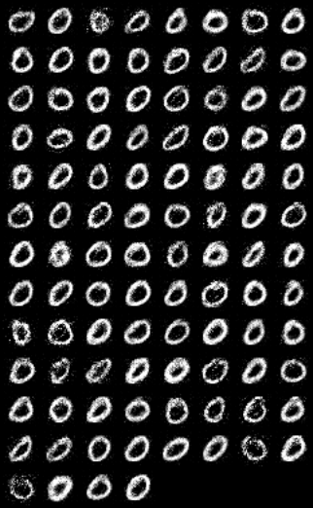
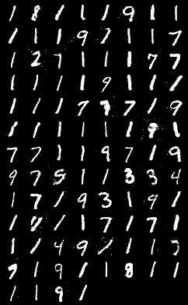
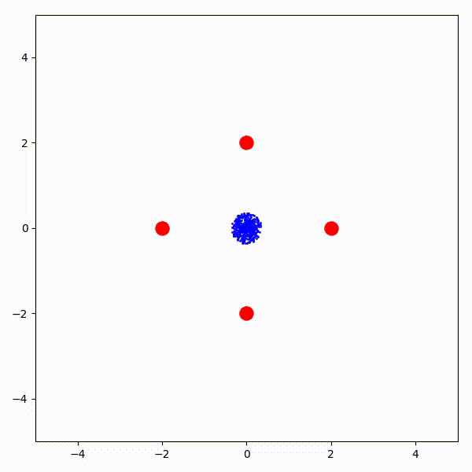
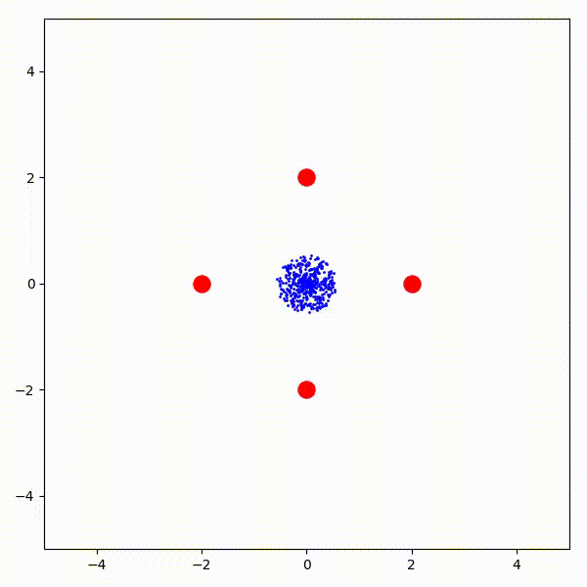
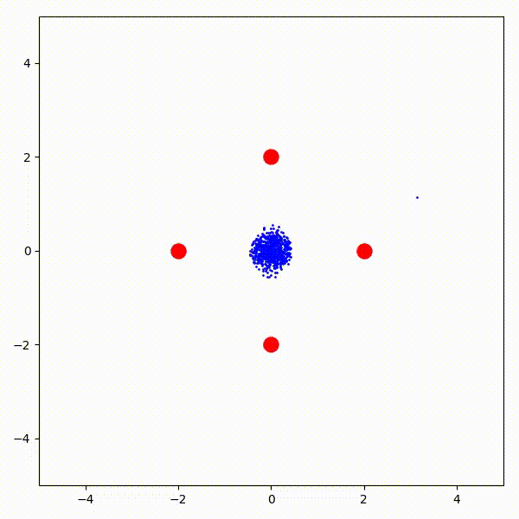
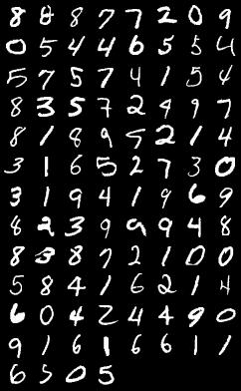
Ensembles: Robustness
Mixture of generators overcomes mode collapse
g₂
g₃
g₄
…
g₁
w²
w³
w¹
w⁴

Slide 45



Loss Diversity: Robustness
Mustangs: For each training epoch, each cell randomly picks a loss function to optimize the networks’ weights
G_{i}
D_{i}
Update weights
3x3 grid
G_{i}
G_{i}
5x5 grid

Slide 46

Ensembles: Better results
The use of evolved ensembles improves quality of the samples
Uniformly distributed weights
Evolved weights

Slide 47
Ensembles: Re-purpose models
Given a set of heterogeneous generators that were optimized for one objective (e.g., FID), create ensembles for optimizing a different objective
Ensemble size | TVD - Diversity (new objective) | FID - Accuracy (old objective)
1 | 0.113 | 36.393
3 | 0.046 | 27.576
4 | 0.043 | 27.890
5 | 0.046 | 28.225
6 | 0.045 | 27.077
<8 | 0.033 | 27.342
High quality
Low diversity
High quality
High diversity

Slide 48

Improvements: Data Dieting
As we have communication between cells, do we need to replicate whole data among all the cells? Data diversity

Slide 49

Improvements: Data Dieting
Spatial distribution in a 2D grid addressees the quadratic computational complexity
Asynchronous communication
Deployed over workstations, cloud based, and HPC environments
OpenStack, Google Cloud, AWS, Summit, MIT Satori, etc.

Slide 50
Some implemented approaches
Conditional GAN
Wasserstein GAN
Deep Convolutional GAN
Semi-supervised learning
Temporal (LSTM) based generative models

Slide 51
Publications
Lipizzaner: A System That Scales Robust Generative Adversarial Network Training. E. Hemberg, A. Al-Dujaili, T. Schmiedlechner, U. O'Reilly. Systems for Machine Learning workshop@ NeurIPS 2018.
An Artificial Coevolutionary Framework for Adversarial AI. Una-May O’Reilly, Erik Hemberg. AAAI Fall Symposia, 2018.
Towards Distributed Coevolutionary GANs. Abdullah Al-Dujaili, Tom Schmiedlechner, Erik Hemberg, Una-May O'Reilly. AAAI Fall Symposia, 2018.
Spatial Evolutionary Generative Adversarial Networks. Jamal Toutouh, Erik Hemberg, Una-May O'Reilly. GECCO, 2019.
Data Dieting in GAN Training. Jamal Toutouh, Erik Hemberg, Una-May O'Reilly. Deep Neural Evolution: Deep Learning with Evolutionary Computation (2020).
Re-purposing Heterogeneous Generative Ensembles with Evolutionary Computation. Jamal Toutouh, Erik Hemberg, Una-May O'Reilly. GECCO, 2020.
Parallel/distributed implementation of cellular training for generative adversarial neural networks. E. Perez, S. Nesmachnow, J. Toutouh, E. Hemberg, U. O'Reilly. PDCO 2020
Selection Pressure and Communication in Evolutionary GAN Training. Jamal Toutouh, Erik Hemberg, Una-May O'Reilly. PPSN 2020 (Under review).
Spatial Coevolution for the Robust and Scalable Training of Generative Adversarial Networks. Erik Hemberg, Jamal Toutouh, Una-May O'Reilly. ACM Transactions on Evolutionary Computing (Under review).

Slide 52
Thanks!
Comments?
JAMAL TOUTOUH jamal@lcc.uma.es
jamal.es
@jamtou
14-Nov-21
52
Jamal Toutouh

